Slide 1
Introduction to Image Processing
Dr. N.Santhiyakumari
Prof/Head
Department of ECE
Knowledge Institute of Technology
santhiyarajee@gmail.com

Slide 2
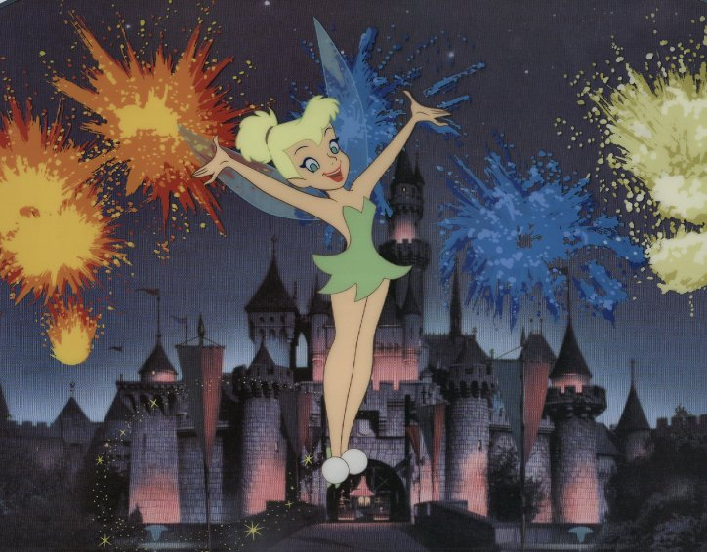
A picture is worth a thousand words!

Slide 3
What is an Image?
• Formal Definition: A digital image is a multi-dimensional signal
that is sampled in space and/or time and quantized in amplitude.
• Looser Definition: An image is a picture. The brightness values in
the picture may represent distance, reflectivity, density, temperature,
etc.
• The image may be 2-D (planar), 3-D (volumetric), or N-D.
• Image elements
An image is composed of a finite number of elements, each of which
has a particular location and value.
2-D: pixels = picture elements
3-D: voxels = volume elements
4-D and higher: hypervoxels = hypervolume elements

Slide 4
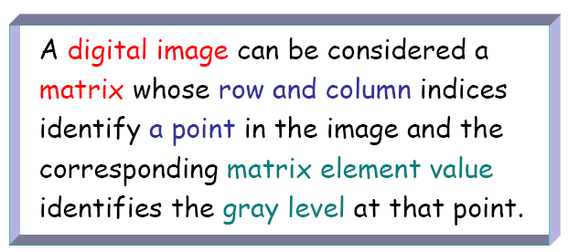
What is a digital image ?

Slide 5
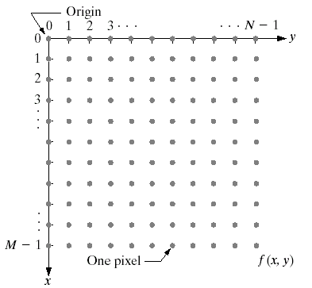
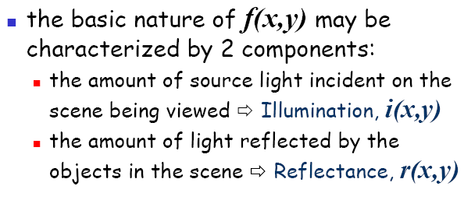

Slide 6
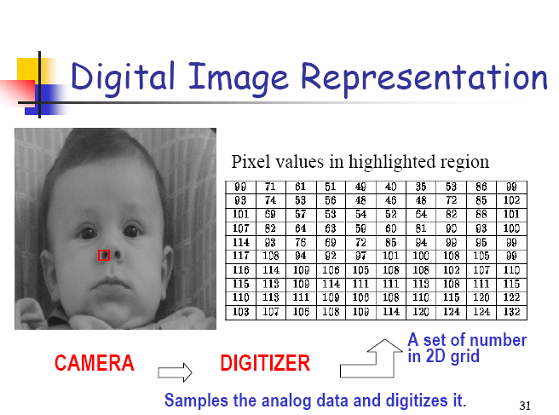

6

Slide 7

What is Image Processing?
It is a discipline in which both input and output of a process are images.

Slide 8
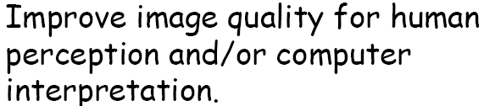
Human perception is limited to visual band of Electromagnetic (EM)spectrum.
Imaging machines cover almost the entire EM spectrum.

Slide 9
Why do we process images?
Facilitate picture storage and transmission
– Efficiently store an image in a digital camera
– Send an image from Mars to Earth
Prepare for display or printing
– Adjust image size
– Half toning
Enhance and restore images
– Remove scratches from an old movie
– Improve visibility of tumor in a radiograph
Extract information from images
– Read the ZIP code on a letter
– Measure water pollution from aerial images

Slide 10
Processing of image data for storage, transmission and representation for autonomous machine perception.
Image analysis – Image understanding
Area inbetween Image processing and Computer Vision (Computers used to emulate human vision).

Slide 11
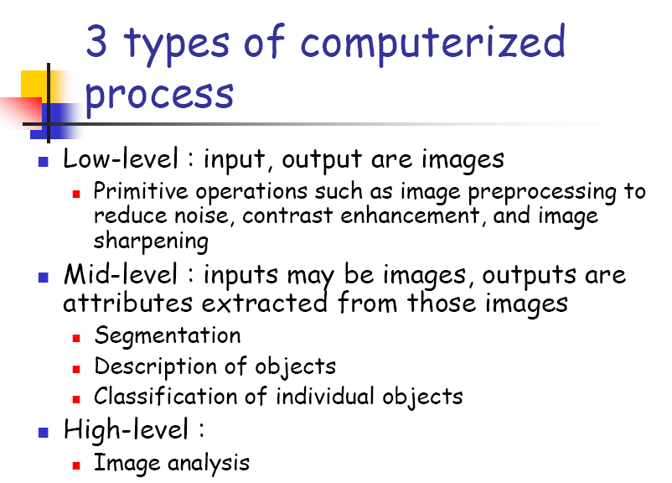

Slide 12
Image analysis
(Image understanding)
It is an area inbetween Image processing and Computer Vision (Computers used to emulate human vision).

Slide 13
History
Photography appeared in XIX century.
Ideas for developing fax machines and usage of telegraphic lines for image submission was born during the World War I.
The idea about TV development was born around 1930.
The key event in digital image processing was development of the first electronic computing machines. These machines enabled simple and fast image processing.
The second important event was astronomical exploration and race to space.
California had the first task related to the digital image processing within NASA USA space program.

Slide 14
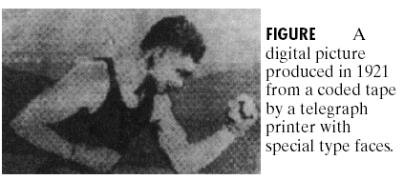
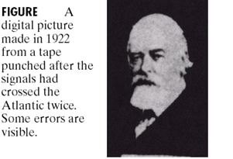
Fundamentals
Transmission of images
mages

Slide 15
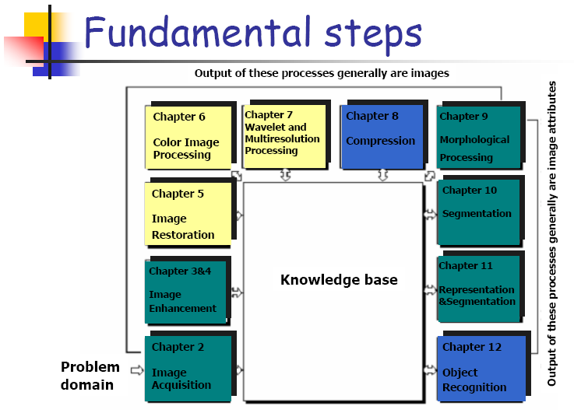

Slide 16
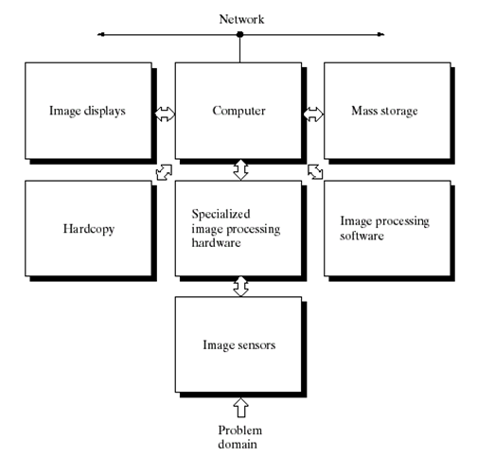

Slide 17
Image Acquisition

Slide 18
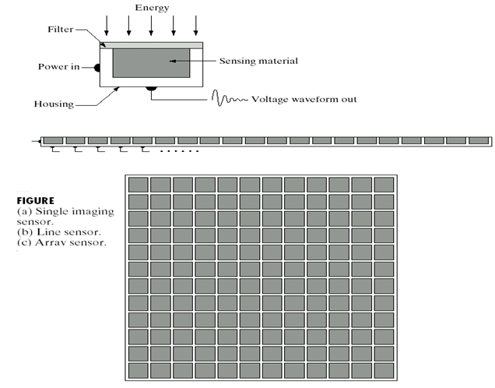
Fundamentals
Acquisition
Image sensing

Slide 19
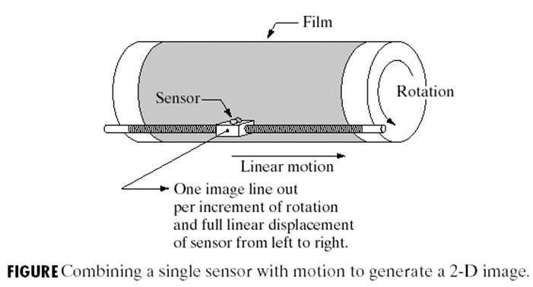
Fundamentals
Acquisition
Image Acquisition

Slide 20
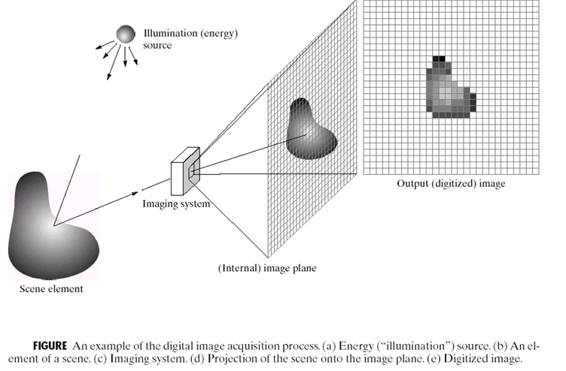
Fundamentals
Digital Image Acquisition Process
Acquisition

Slide 21
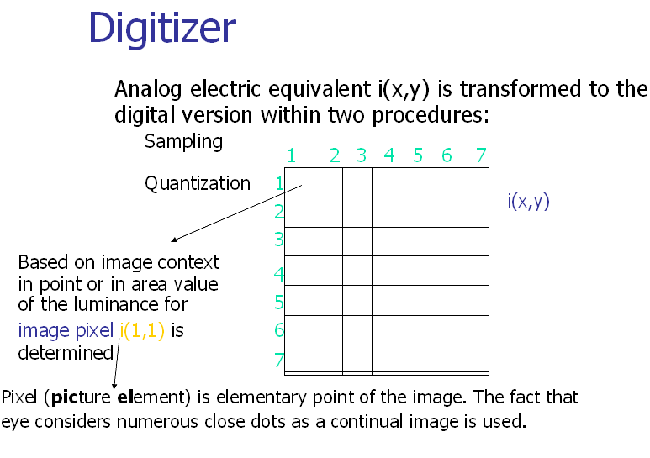

Slide 22
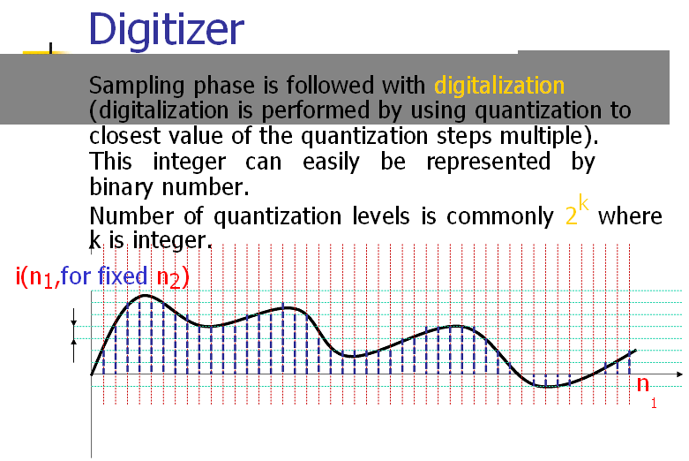

Slide 23
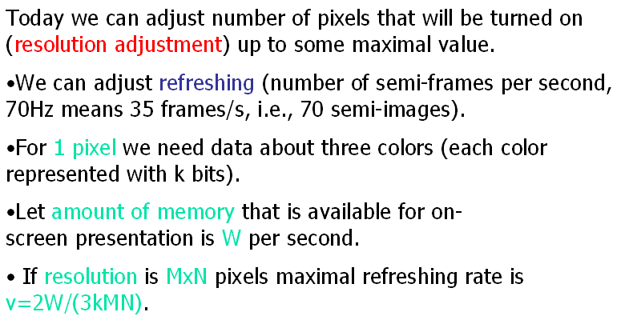
Refreshing and Resolution

Slide 24
Image Enhancement

Slide 25
Accentuate certain desired features for subsequent
analysis or display i.e. Highlight certain features of
interest in an image
Increase the contrast of an image – It looks better.
It is a very subjective area of Image processing.
Process an image so that the result will be more
suitable than the original image for a specific
application.
The suitableness is upto each application.

Slide 26
Spatial Domain : (image plane)
  Techniques are based on direct manipulation of pixels in an image.
Frequency Domain :
  Techniques are based on modifying the Fourier transform of an image.
There are some enhancement techniques based on various combinations of methods from these two categories.

Slide 27
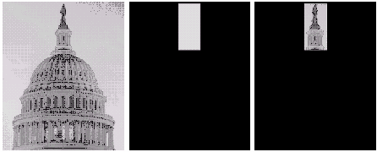
AND operation
original image
AND image
mask
result of AND operation

Slide 28
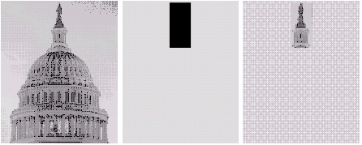
Example of OR Operation
original image
OR image
mask
result of OR operation

Slide 29
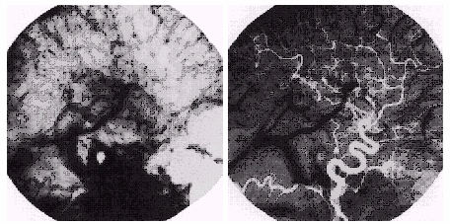
Image Subtraction
mask image
an image (taken after injection of a contrast medium (iodine) into the bloodstream) with mask subtracted out.

Slide 30
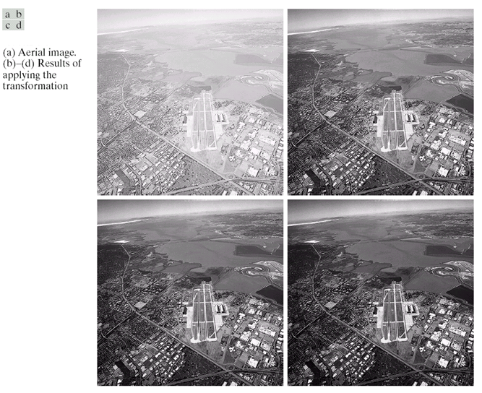
λ
s=cr

Slide 31
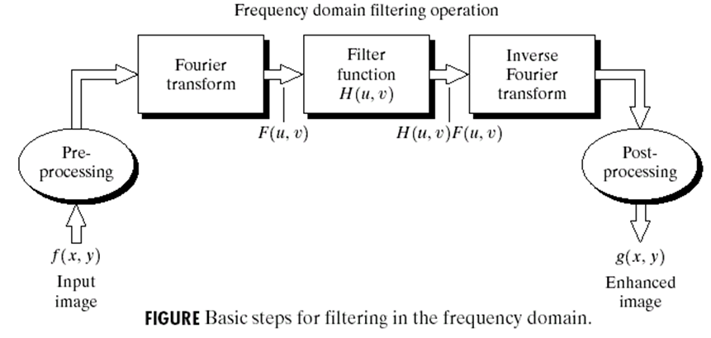
Basic steps for filtering in the frequency domain

Slide 32
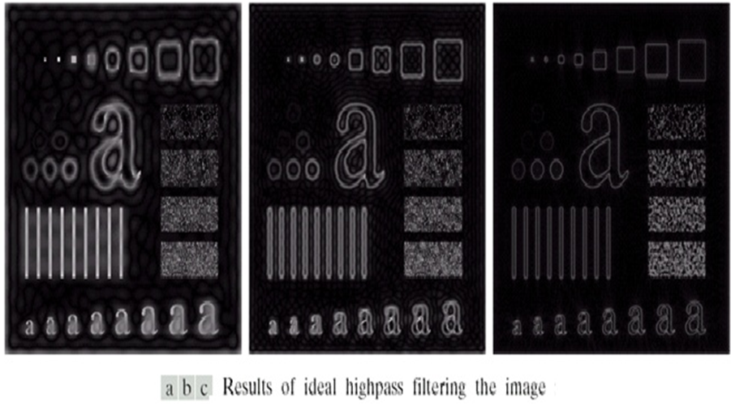

Slide 33
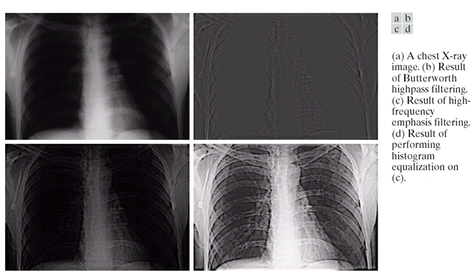

Slide 34
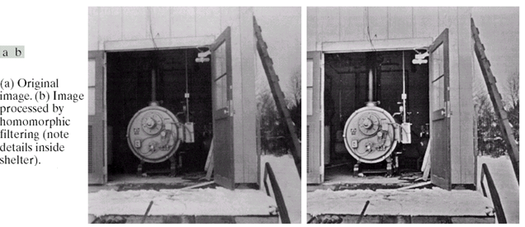

Slide 35
Color model and image
All colors that can be seen by humans can be described with combination of three images coming from our cone cells in our eyes sensitive to blue, green and red color.
Then all colors can be represented as a vector with three components color=[r,g,b].
Note that T. Young has found in 1802. that combination of three independent colors (!) can produce all visible colors.
This model is called three channel model where channels are shades of particular colors in the model.

Slide 36
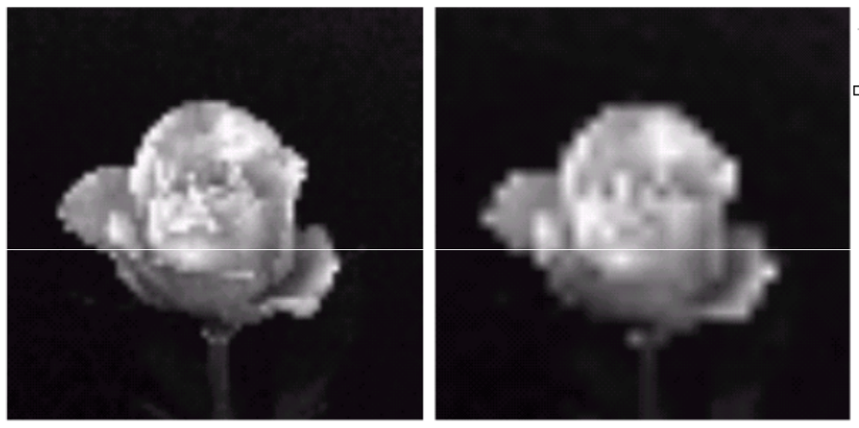
Fundamentals
Sharpness
The eye is able to deal with sharpness in different distances
n different distances
Sharpness

Slide 37
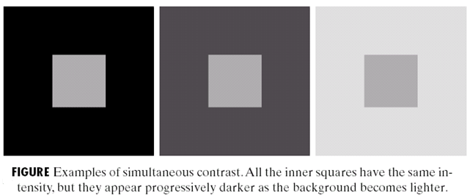
Fundamentals
Brightness
The eye is able to adapt to different ranges of brightness

Slide 38
Fundamentals
Easier: 2D array of cells, modelling the
cones/rods
s
Each cell contains a numerical value (e.g.between 0-255)

Slide 39
Fundamentals
The position of each cell defines the position of the receptor
The numerical value of the cell represents the illumination received by the receptor
5
7
1
0
12
4
…
…
…

Slide 40
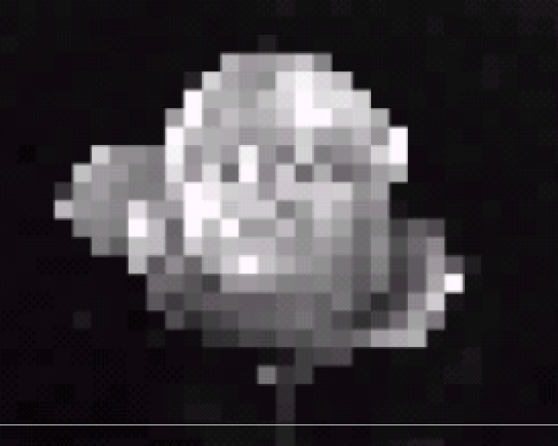
Fundamentals
GRAYVALUE image
Value = 0: BLACK (no illumination / energy)
Value = 255: White (max. illumination / energy)
is model, we can create GRAYVALUE images
Value = 0: BLACK (no illumination / energy)
Value = 255: White (max. illumination / energy)

Slide 41
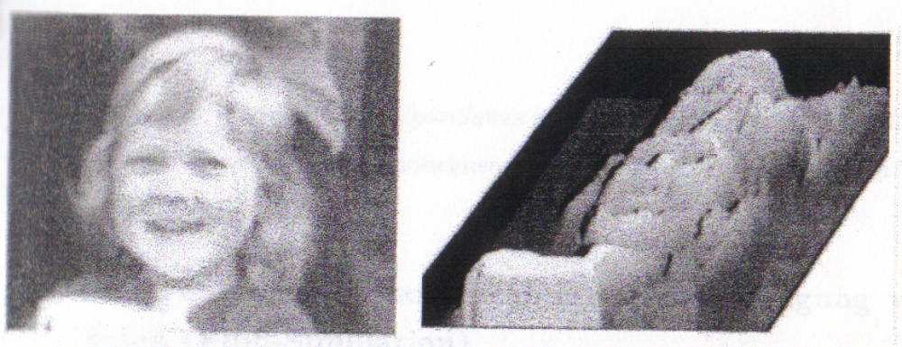
Fundamentals
A 2D gray value - image is a 2D -> 1D function,
v = f (x, y)

Slide 42
Fundamentals
To e.g.
H(f (x, y)) = f (x, y) / 2
Operator
Operator
Image (= function)

Slide 43
Fundamentals
H(f(x, y)) = f(x, y) / 2
6
8
2
0
3
4
1
0
12
200
20
10
6
100
10
5

Slide 44


Fundamentals
Remember: the value of the cells is the illumination (or brightness)
Remember: the value of the cells is
the illumination (or brightness)
6
8
2
0
3
4
1
0
12
200
20
10
6
100
10
5

Slide 45
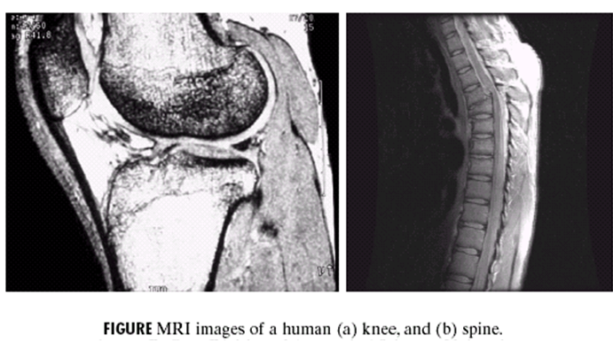
Fundamentals
Image Enhancement

Slide 46
Fundamentals
Representation
Black/White and Color

Slide 47
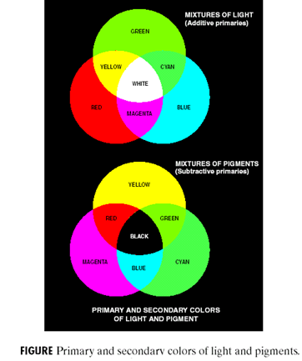
Fundamentals
Color Representation: Red / Green /Blue Blue
Model for
Color-tube

Slide 48
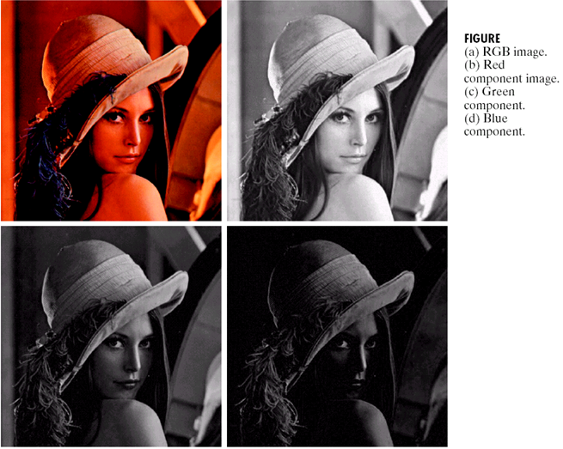

Slide 49
Fundamentals
Color images can be represented by
3D Arrays (e.g. 320 x 240 x 3)

Slide 50
Fundamentals
But for the time being we’ll handle 2D gray value images

Slide 51
Fundamentals
Digital vs. Analogue Images
Analogue:
Function v = f(x, y): v, x, y are REAL
Digital:
Function v = f(x, y): v, x, y are INTEGER

Slide 52
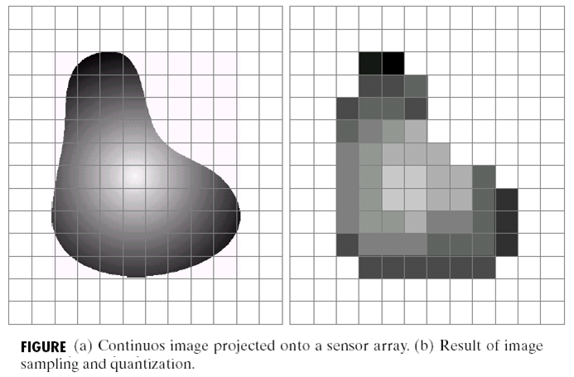
Fundamentals
Stepping down from REALity to INTEGER coordinates x,y: Sampling

Slide 53
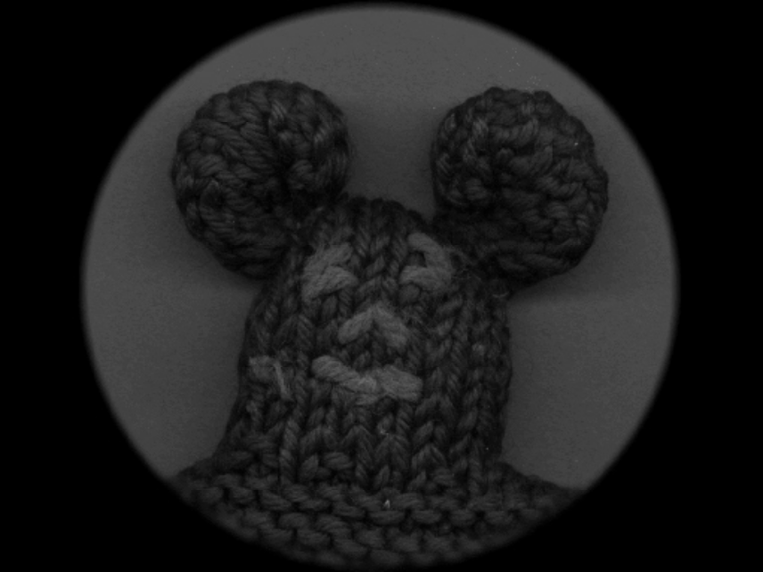
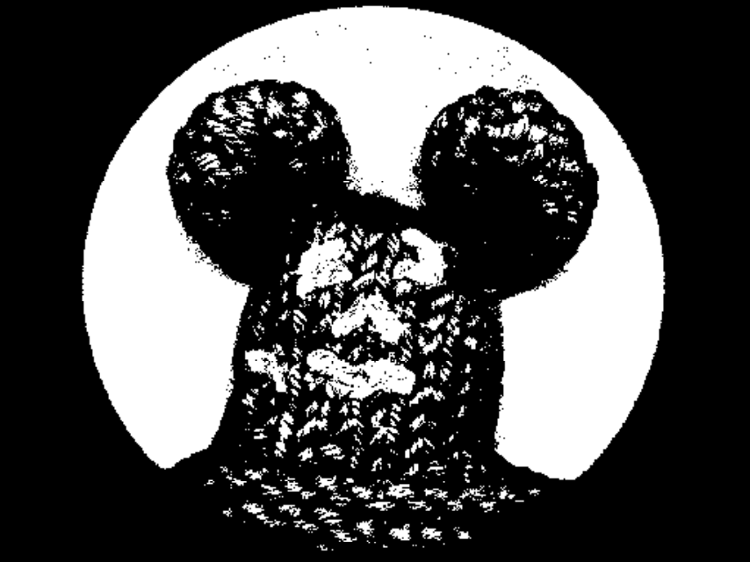
Fundamentals
Stepping down from REALity to INTEGER grayvalues v : Quantization

Slide 54
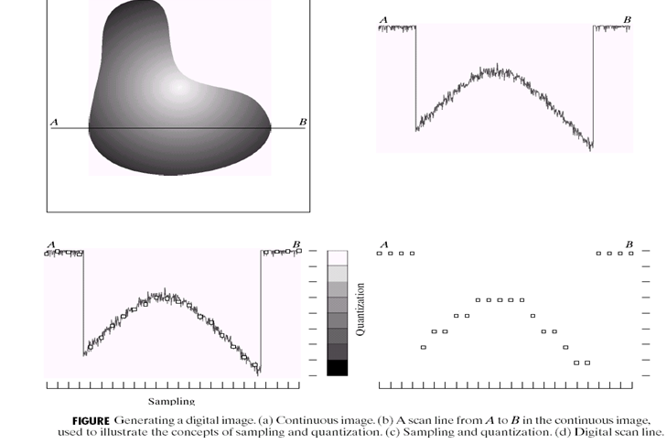
Fundamentals
Sampling
and
Quantization
Sampling
and
Quantization

Slide 55
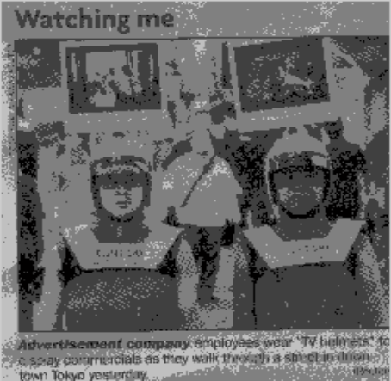
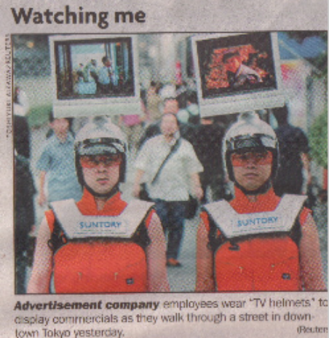
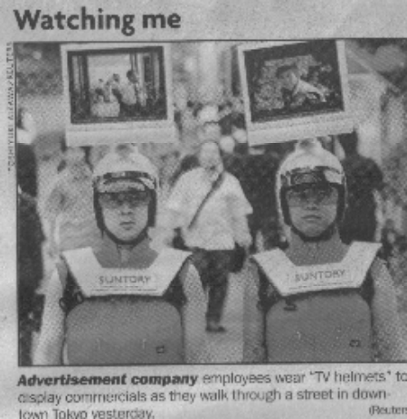
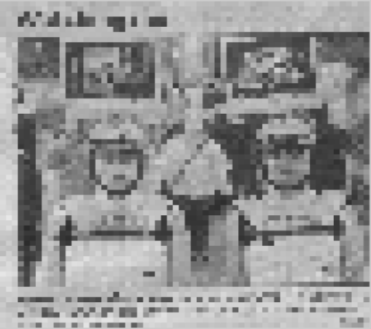
Fundamentals
MATLAB demonstrations of sampling and quantization effects

Slide 56
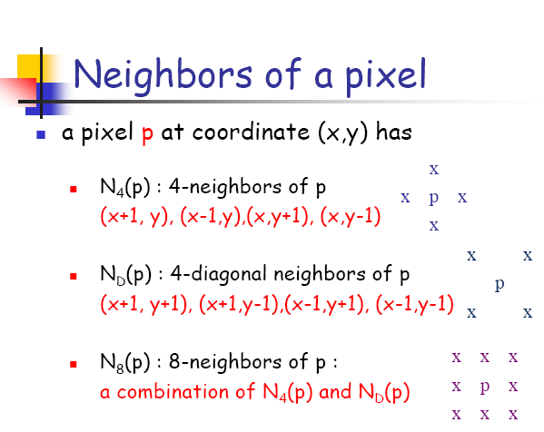

Slide 57
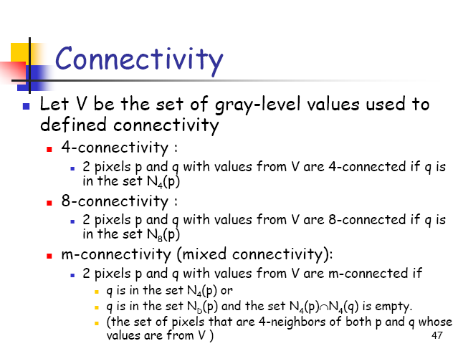
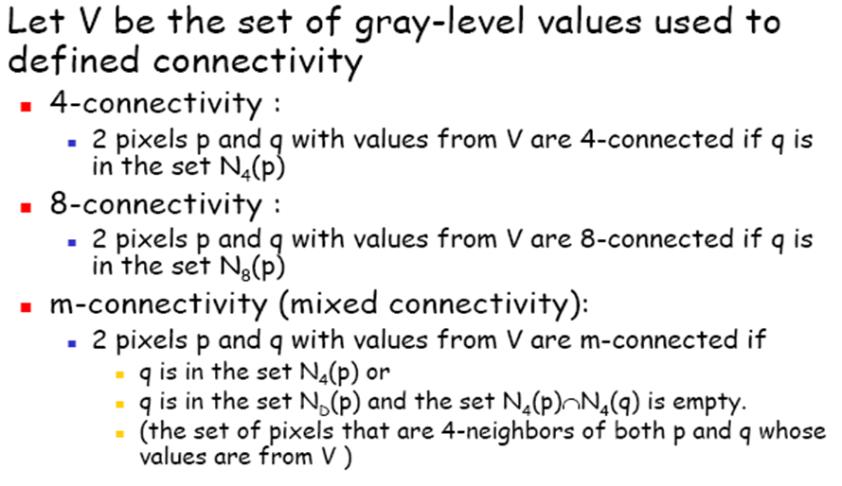

Slide 58
Image restoration / image filtering
Remove or minimize known degradations.

Slide 59
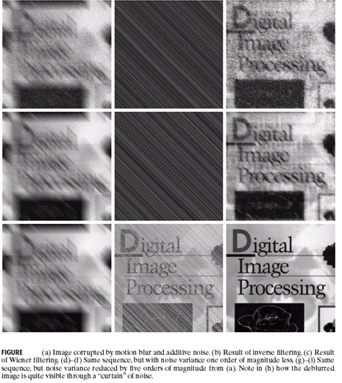

Slide 60
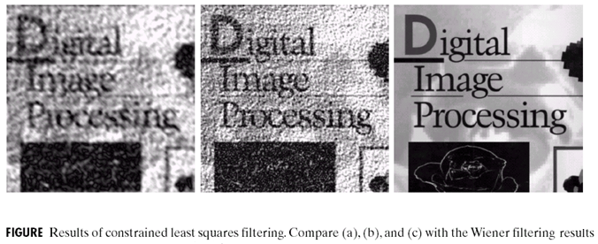

Slide 61
Image segmentation
Segmentation refers to the process of partitioning a digital image into multiple regions (sets of pixels).
The goal of segmentation is to simplify and/or change the representation of an image into something that is more meaningful and easier to analyze.
Image segmentation is typically used to locate objects and boundaries (lines, curves, etc.) in images.
Each of the pixels in a region are similar with respect to some characteristic or computed property, such as color, intensity, or texture.
Adjacent regions are significantly different with respect to the same characteristic(s).

Slide 62
Edges
Thresholding
Region Based (Region growing or Split and merge)

Slide 63
Partition of the image into regions that correspond to anatomical structures.
Medical purpose:
Identification and classification of organs or tumours, volume measurement.
Mathematical:
Homogeneous regions, regions with small gradients, connectedness.
Problems:
Noisy images and smooth boundaries
Several semiautomatic approaches, but up to now automatic
segmentation is very difficult problem.

Slide 64
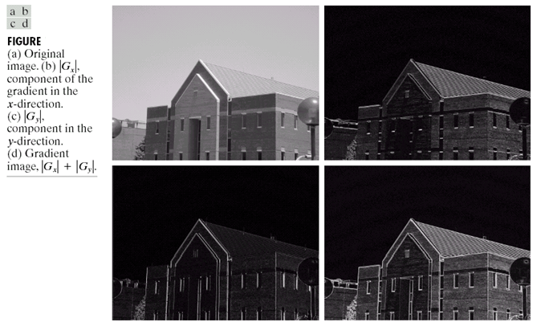

Slide 65
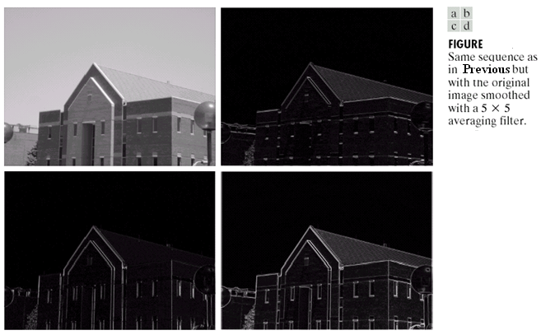

Slide 66
Image Compression
Efficient storage, transmission.

Slide 67
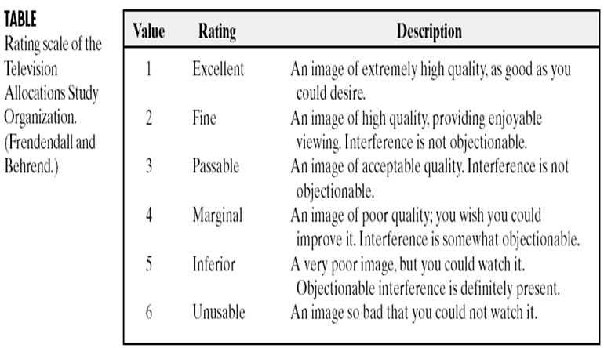

Slide 68


Slide 69
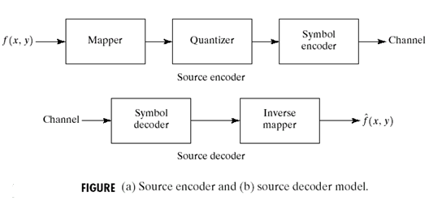

Slide 70
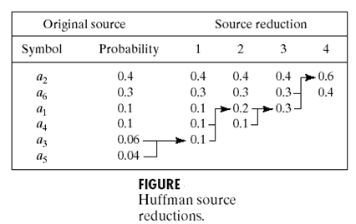

Slide 71


Slide 72


Slide 73


Slide 74


Slide 75


Slide 76


Slide 77


Slide 78


Slide 79


Slide 80
Image analysis / computer vision
Extracting information from images, can be quantitative (e.g., object dimensions or position) or symbolic (e.g., character recognition).

Slide 81
Applications
Some of the practical applications of image segmentation are:
Medical Imaging
  Locate tumors and other pathologies
  Measure tissue volumes
  Computer-guided surgery
  Diagnosis
  Treatment planning
  Study of anatomical structure
Locate objects in satellite images (roads, forests, etc.)
Face recognition
Fingerprint recognition
Automatic traffic controlling systems

Slide 82
What is BME ?
Biomedical engineering concerns the application of engineering principles
  to medical problems
  including the replacement of damaged organs
  instrumentation
  systems of health care
  including diagnostic applications of computers

Slide 83

Broad Classification

Slide 84
Diagnostic Instrument
    Designed to determine
      physical signs of disease and/or injury
      without alteration of the structure and function of the biological system
      and may be of image based, biochemical based or transducer based.

Slide 85
What is Medical Imaging?
The study of medical imaging is concerned with the interaction of all forms of radiation with tissue and the development of appropriate technology to extract clinically useful information (usually displayed in an image format) from observation of this technology.

Slide 86
Sources of Images
Structural/anatomical information (CT, MRI, US) - within each elemental volume, tissue-differentiating properties are measured.
Information about function (PET, SPECT, fMRI).

Slide 87
Medical Imaging
Definition: Capturing structural or functional spatial detail of the body using a suitable energy source.
Structural – captures anatomical information such as location, extent of tissues and organs.
  X-ray, CT, MRI, Ultrasound.
Functional – captures functional data, regarding physiological processes such as metabolic activity, neurotransmission …. PET, SPECT, FMRI.

Slide 88
Medical Imaging
Transmission Imaging: Energy Source outside the body, image acquired from energy transmitted by the body matter.
  X-rays, CT, MRI, Ultrasound
Emission Imaging: Energy source within body, image acquired from energy emitted from within the body.
  SPECT, PET
MRI and Ultrasound actually image reemitted RF and reflected sound energy respectively

Slide 89
Major Advances in Medical Imaging
These major advances can play a major role in early detection, diagnosis, and computerized treatment planning in cancer radiation therapy.
Image Segmentation
Image Classification
Computer-Aided diagnosis Systems
Content-based Image Retrieval
Image Annotation

Slide 90
Introduction to Medical Image Analysis

Slide 91

Image Processing in the Clinical Workflow

Slide 92
DICOM standard in Medical Imaging
DICOM: "Digital Imaging and Communication in Medicine”
The DICOM Standard allows to get pixel data for each produced image and to associate specific information to them:
name of the patient,
type of examination, hospital,
date of examination,
type of acquisition etc...

Slide 93


Medical Imaging pipeline

Slide 94



Slide 95


Slide 96


Slide 97


Slide 98


STRUCTURAL IMAGING
Radiograph of the hand of Röntgen’s wife, 1895.
Wilhelm Röntgen, Wurtzburg
Nov. 1895 – Announces X-ray discovery
Jan. 13, 1896 – Images needle in patient’s hand
– X-ray used presurgically
1901 – Receives first Nobel Prize in Physics
– Given for discovery and use of X-rays.

Slide 99
Early Developments
Intensifying agents, contrast agents all developed within several years.
Creativity of physicians resulted in significant improvements to imaging.
Found ways to selectively opacify regions of interest.
Agents administered orally, intravenously, or via catheter.

Slide 100
Later Developments
More recently, physicists and engineers have initiated new developments in technology, rather than physicians.
1940’s, 1950’s
  Background laid for ultrasound and nuclear medicine
1960’s
  Revolution in imaging – ultrasound and nuclear medicine
1970’s
  CT (Computerized Tomography)
  true 3D imaging
1980’s
  MRI (Magnetic Resonance Imaging)
  PET ( Positron Emission Tomography)

Slide 101



Computerized Tomography (CT)
Result:
1972 Hounsfield announces findings at British Institute of Radiology
Hounsfield, Cormack receive Nobel Prize in Medicine
(CT images computed to actually display attenuation coefficient m(x, y))

Slide 102

First Generation CT Scanner
Acquire a projection (X-ray)
Translate x-ray pencil beam and detector across body and record output
Rotate to next angle
Repeat translation
Assemble all the projections

Slide 103


Computerized Tomography (CT)
Early CT Image
Current technology

Slide 104

Medical Images of Different Modalities
Computer Tomography (CT)

Slide 105

Magnetic Resonance Tomography (MRT/MR/MRI)

Slide 106

Positron Emission Tomography (PET)
Single Photon Emission Computed Tomography (SPECT).

Slide 107

Nuclear Medicine
Grew out of the nuclear reactor research of World War II
Discovery of medically useful radioactive isotope
Radioactive tracer is selectively taken up by organ of interest
Source is thus inside body!
This imaging system measures function (physiology) rather than anatomy.

Slide 108
Nuclear Medicine
Very specific in imaging physiological function - metabolism
- thyroid function
- lung ventilation: inhale agent
- Brain Functioning
Advantage: Direct display of disease process.
Disadvantage: Poor image quality Tomographic systems:
SPECT: single photon emission computerized tomography
PET: positron emission tomography

Slide 109


The Nobel Prize in Physiology / Medicine for 2003 jointly to
Paul C. Lauterbur
Sir Peter Mansfield
Discovered the possibility to create a two-dimensional picture by introducing gradients in the magnetic field.
Developed the utilization of gradients in the magnetic field.
"for their discoveries concerning magnetic resonance imaging“. These discoveries have led to the development of modern magnetic resonance imaging, MRI, which represents a breakthrough in medical diagnostics and research.
http://www.nobel.se/medicine/laureates/2003/press.html

Slide 110


What is fMRI?
Functional Magnetic Resonance Imaging (fMRI) is a powerful imaging technique, which can be used to visualize brain function in vivo, when subjects perform specific task or are exposed to specific stimuli.
1.5 Tesla fMRI scanner at Brain Activity Imaging Center, ATR labs, Kyoto

Slide 111
Functional MRI
Used for functional study of brain activity and brain mapping. The signal used is termed BOLD response.
BOLD is Blood Oxygen Level Dependent. Oxy-haemoglobin and de-oxy haemoglobin have different magnetic properties.
The blood flow in local vasculature is dependent on the neuronal activity and causes a BOLD response on the MR image.
The scans are done with the subject undergoing certain functional activity such as counting, listening, motor activity etc.
Example: For first ten scan subject is at rest, next ten scans subject taps finger (motor activity) and so on.

Slide 112
fMRI as a tool, can be used to visualize the dynamics of brain activity non invasively (in vivo) with reasonable spatial and temporal resolution.
fMRI analysis involves several steps such as preprocessing, statistical analysis and visualization of the results
SPM2 is a widely used software for analysis of fMR images
Apart from Cognitive Neuropsychology applications, fMRI is also proving to be a helpful diagnostic tool for Neurosurgeons and Neurologists.

Slide 113



Slide 114









Slide 115


Slide 116


Slide 117


Slide 118


Slide 119


Slide 121


Slide 122


Slide 123


Slide 124


Slide 125


Slide 126


Slide 127


Slide 128


Slide 129


Slide 130


Slide 131


Slide 132


Slide 133


